Slide 1

DAB101 Project
A Bank chatbot
Link: http://t.me/Alpha60Bot

Slide 2

PURPOSE OF our bankBOT
1) Answering queries related to ATMs.
2) Providing details on Banking, Cards, Loans, Offers Available.
3) Assist Existing Card users.

Slide 3
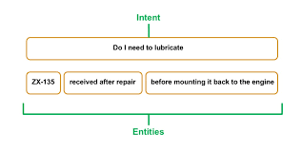
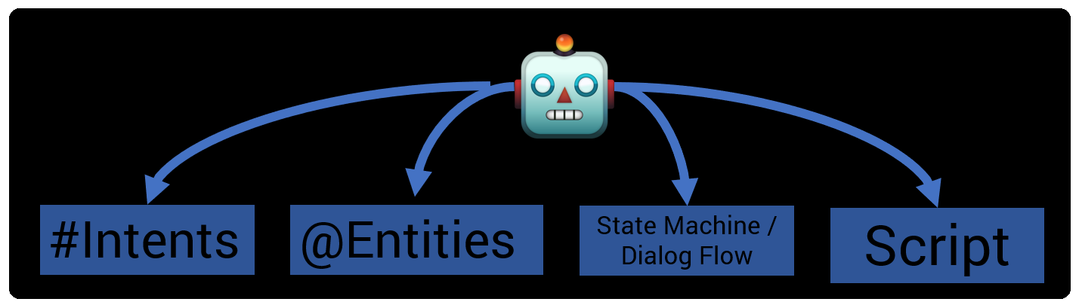
The dictionary
Intents
ATM
Banking hours
Banking
Card
Existing Card
Loan
Loan Fallback
New card option
Offers
Entities
Account Type
Loan Type
New Card
Time Interest

Slide 4


Default Intents
Welcome:
Hello there! Welcome to XYZ Credit Union Bank. How may I assist you?
2) Please select from the options below or ask your own question.
Credit Card
Banking Services
Loans
Offers
Fallback:
Sorry! I don't have an answer to that.
You should select appropriate and available option.

Slide 5
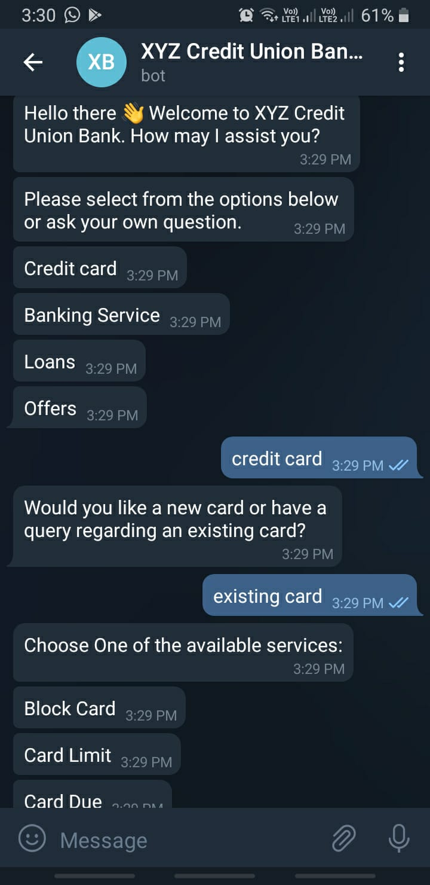
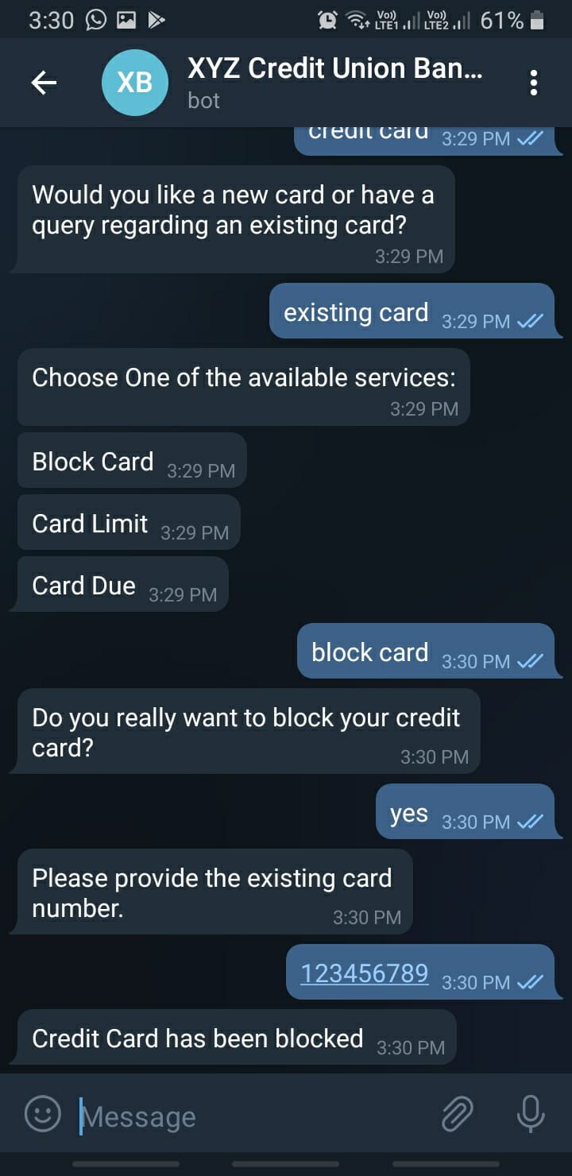
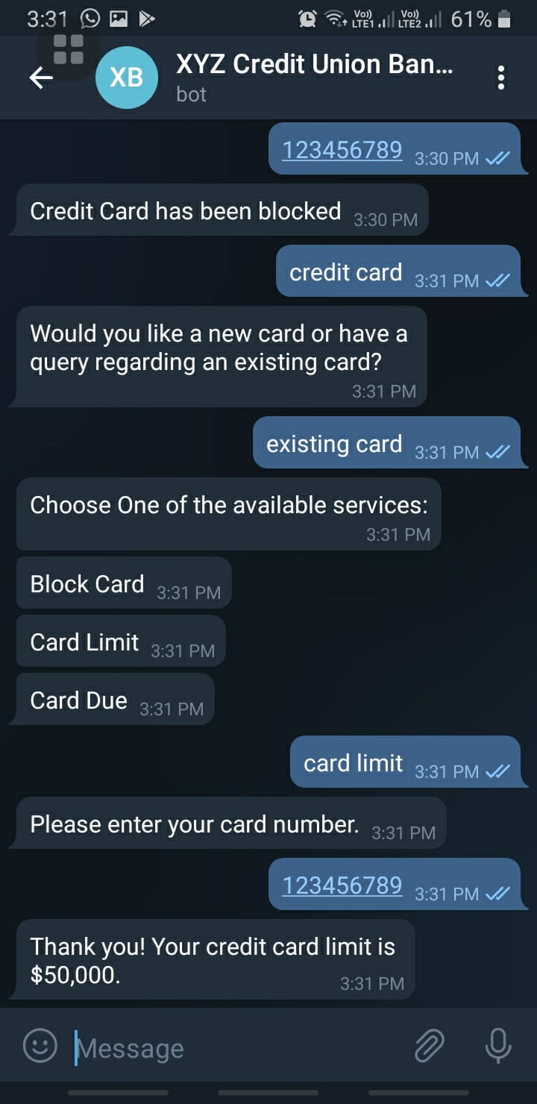
Testing phase:

Slide 6
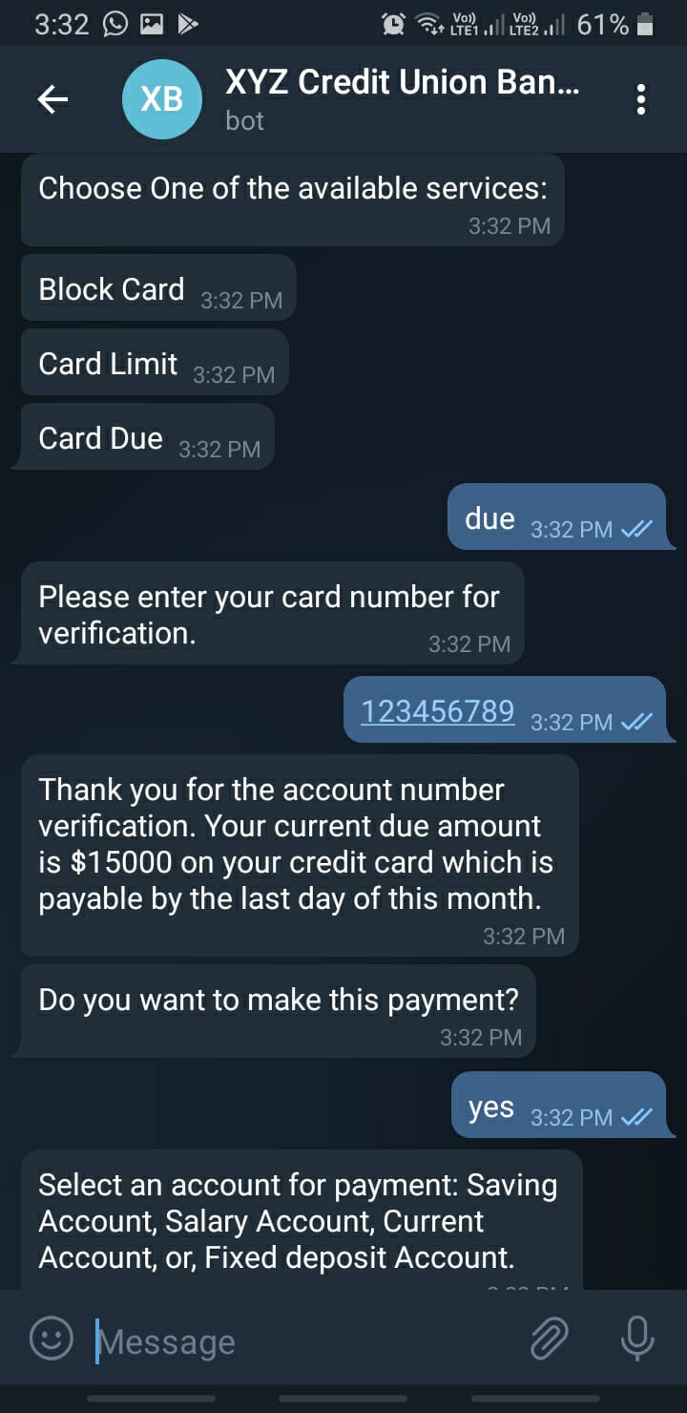
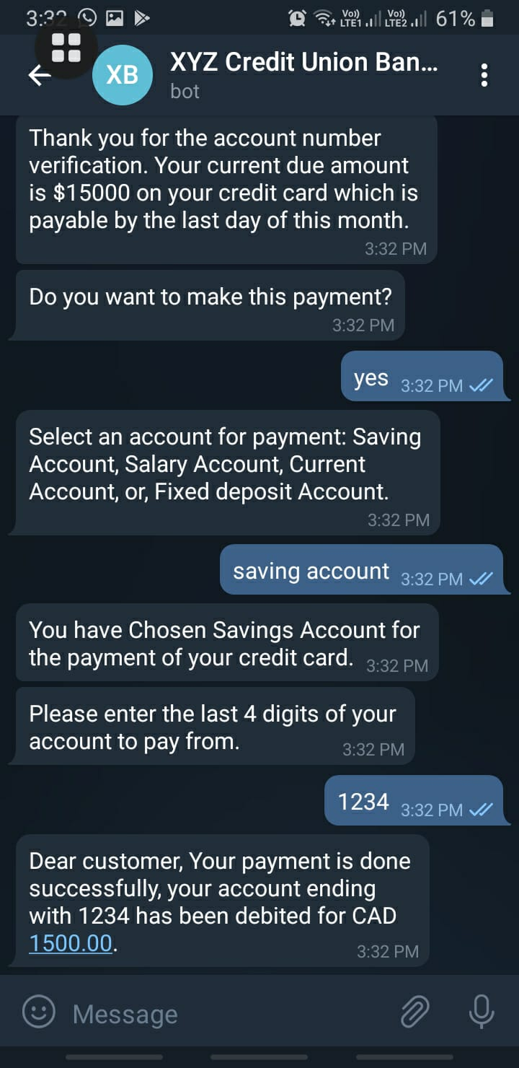
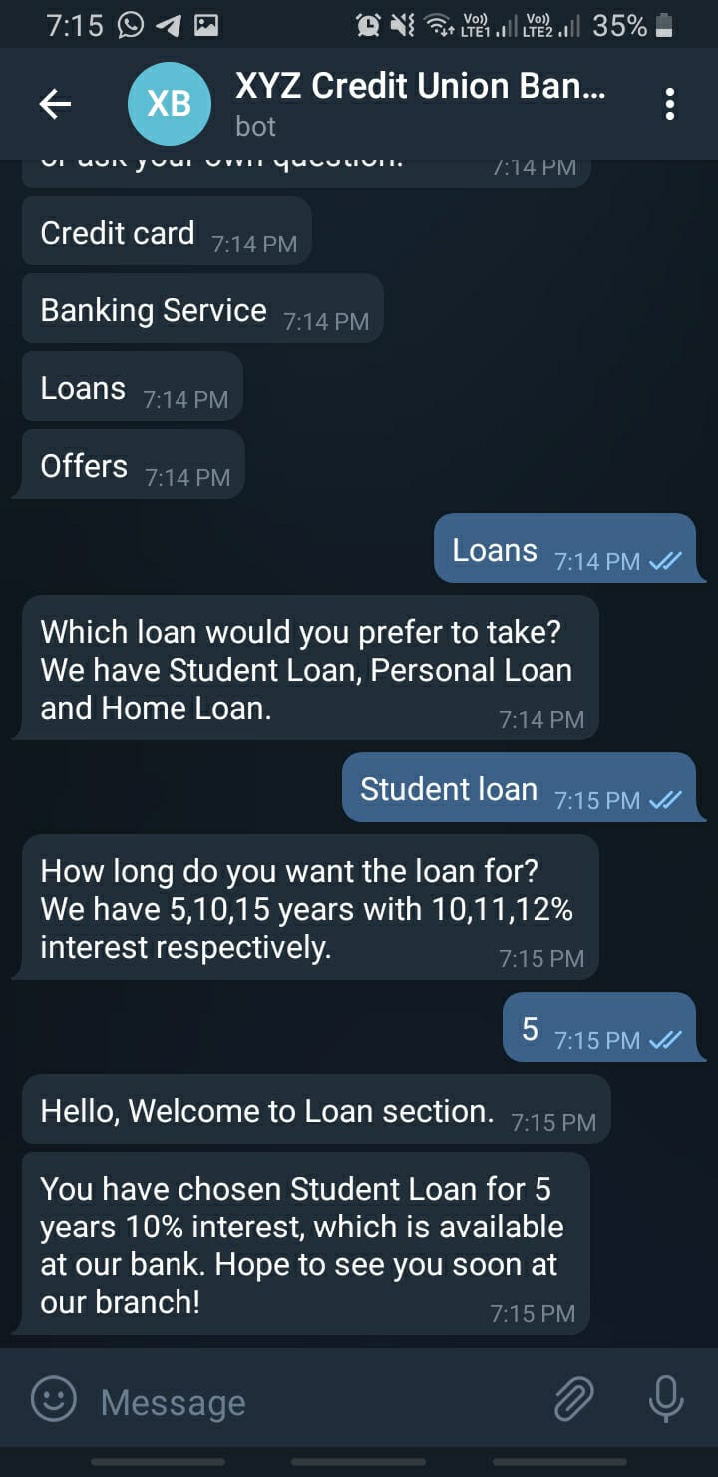
Testing phase:

Slide 7
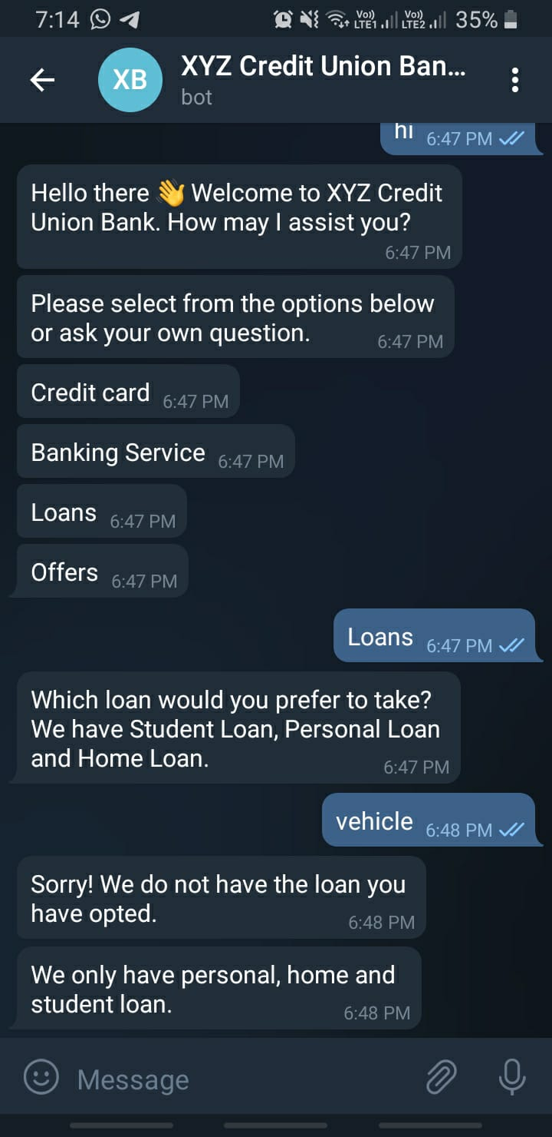
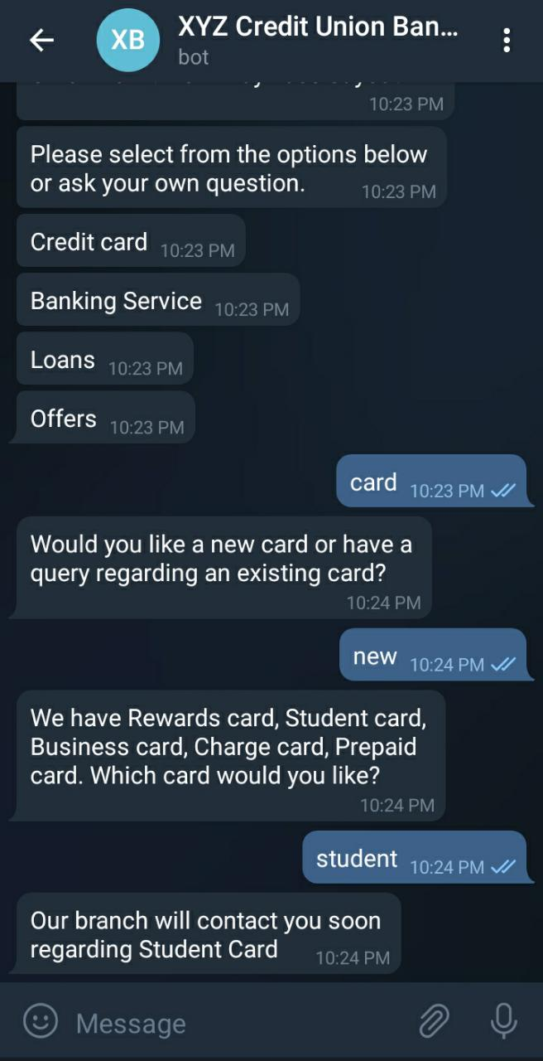
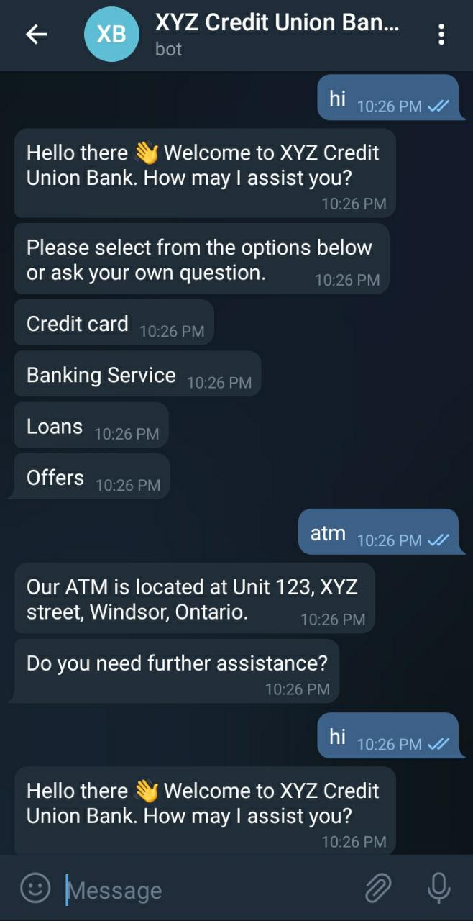
Testing phase:

Slide 8
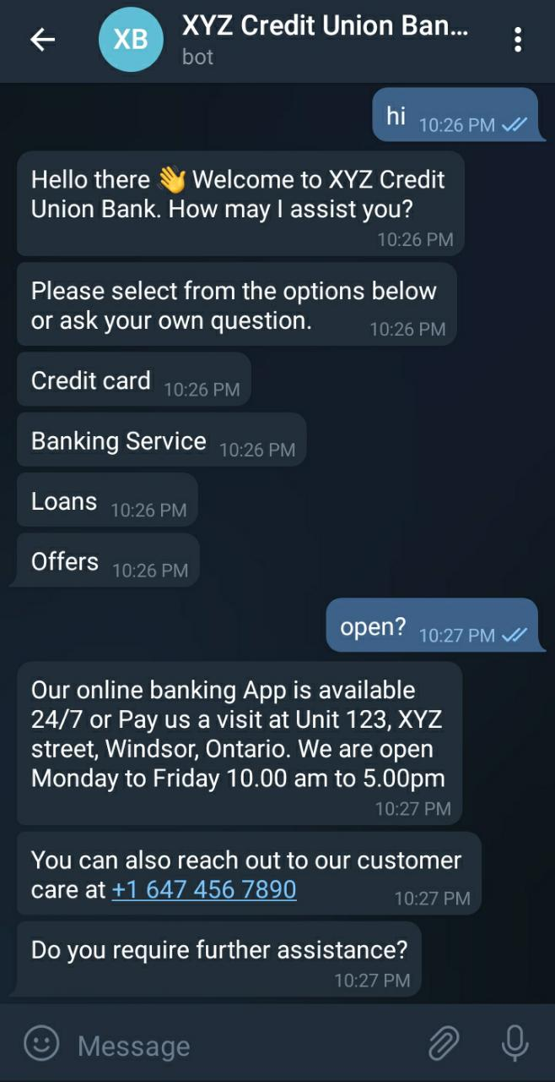
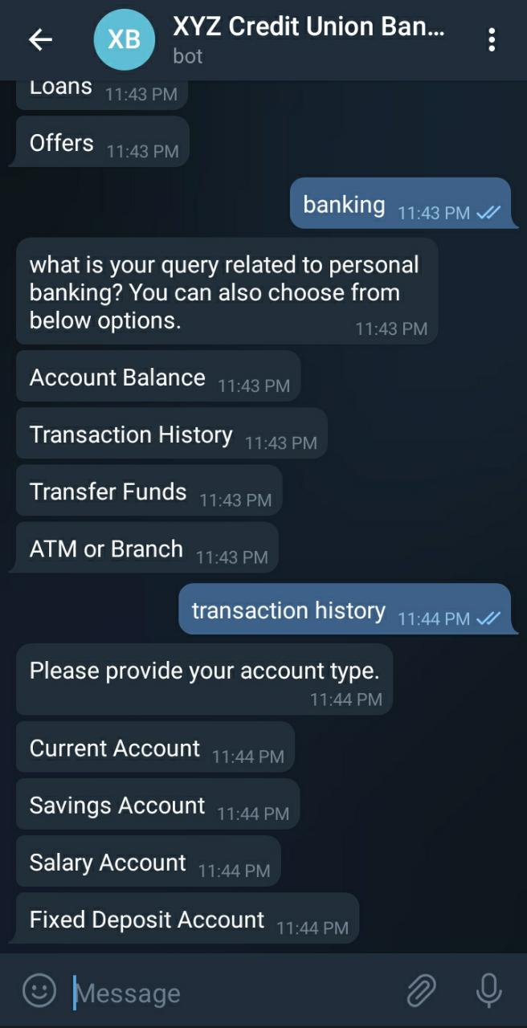
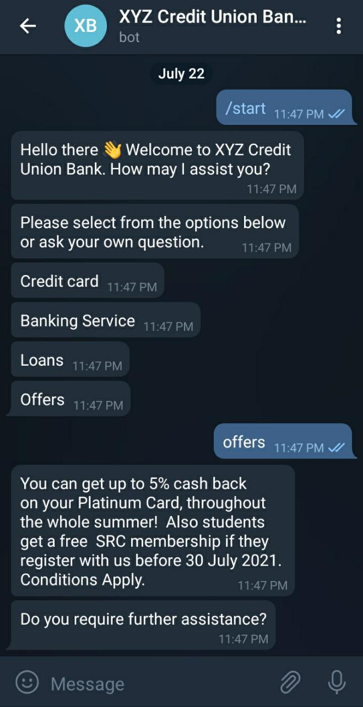
Testing phase:

Slide 9
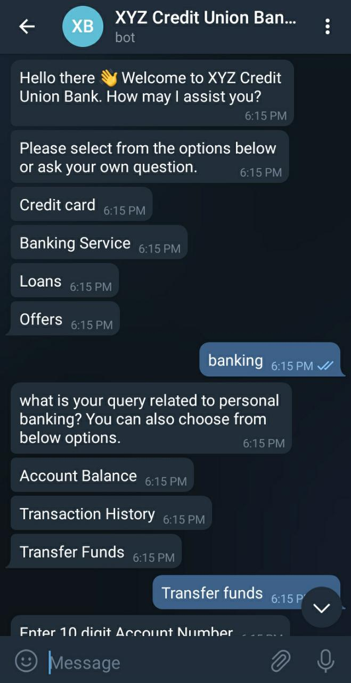
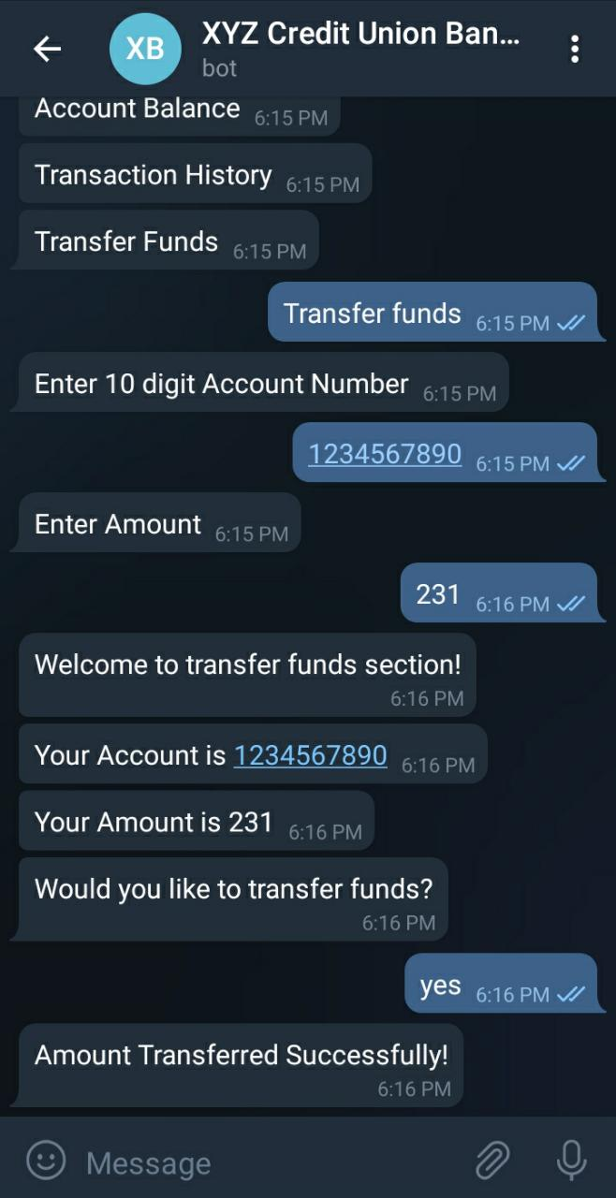
Testing phase:

Slide 10



